Slide 1
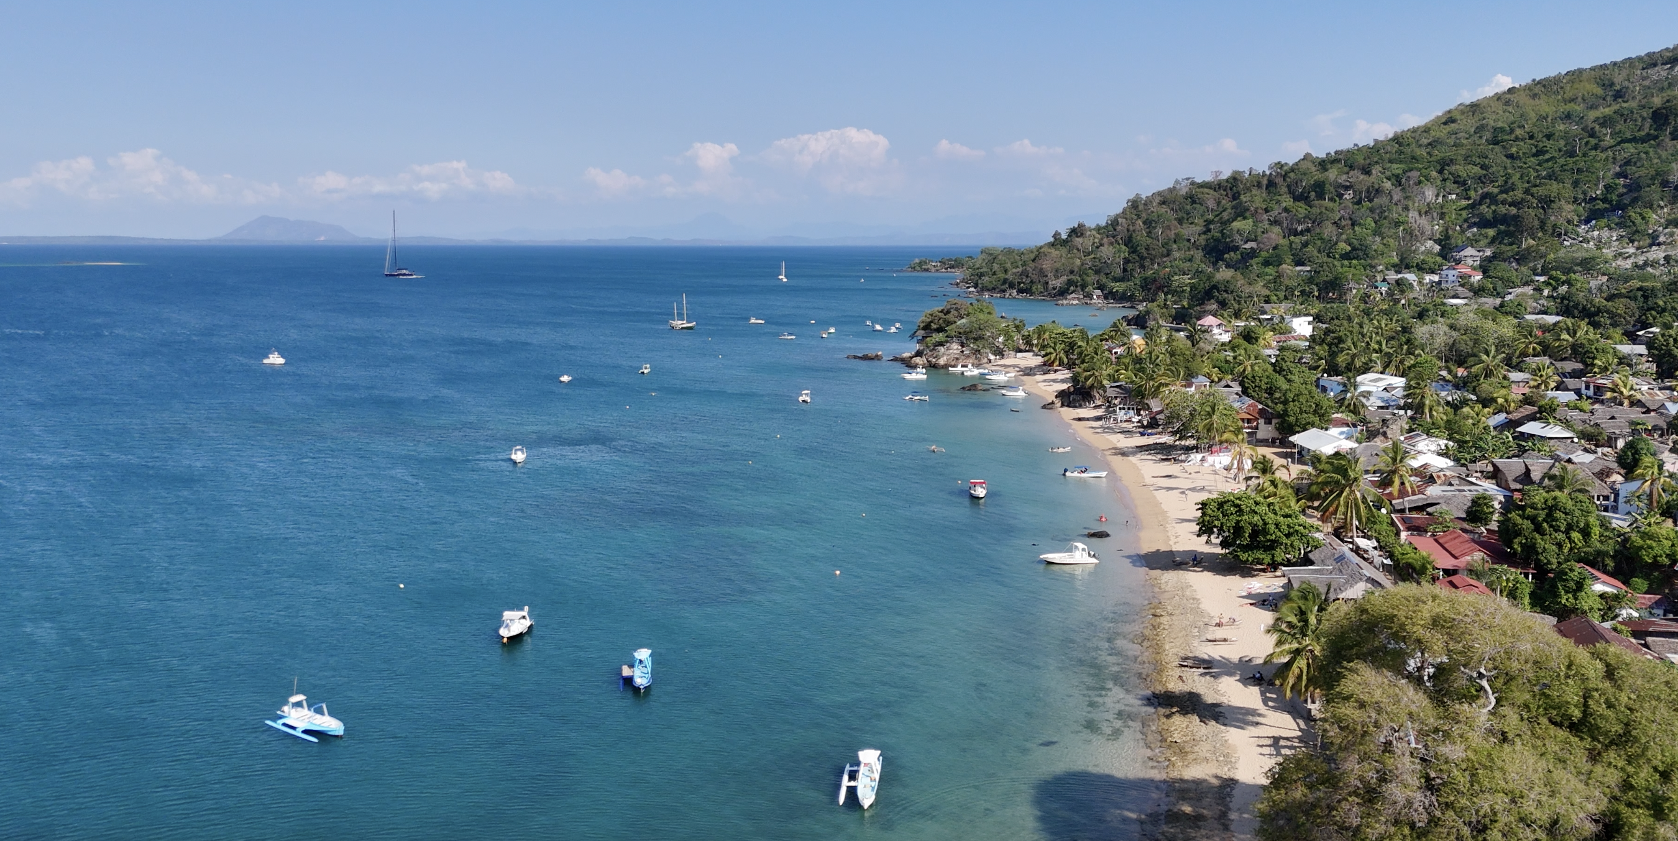
Canopy tearing up to 30cm. -- 40€
Canopy tearing up to 60cm. -- 70€
Canopy tearing beyond 60cm. -- 1,5€/cm
Out of order gear -- 70% retail price
Loss/broken gear -- 70% retail price
Equipment Rentals Terms & Conditions

